Slide 1

Javascript (Template Literals)
by
M NAVEENKUMAR
Assistant Professor
Department of Computer Science and Engineering
SRI RAMACHANDRA ENGINEERING AND TECHNOLOGY
Sri Ramachandra Institute of Higher Education and Research

Slide 2
ES6 Template Literals

Slide 3
Template strings
Prior to ES6, Template strings are used.
<script>
const myNumber = 10;
const myStr = "hello";
const myArr = [20,30];
const myObj = {value:10};
const myBool = true;
const tempString1 = "number is "+myNumber+" my string is "+myStr+" my array is "+myArr;
const tempString2 = "object is "+myObj+"my bool is "+myBool;
console.log(tempString1); // number is 10 my string is hello my array is 20,30
console.log(tempString2);// object is [object Object]my bool is true
</script>

Slide 4
Template Literals
Introduced in ES6 (` template literal ` )
<script>
const myNumber = 10;
const myStr = "hello";
const myArr = [20,30];
const myObj = {value:10};
const myBool = true;
const tempLiteral1 = `number is ${myNumber} my string is ${myStr} my array is ${myArr}`;
const tempLiteral2 = `object is ${myObj} my bool is ${myBool}`;
console.log(tempLiteral1 ); // number is 10 my string is hello my array is 20,30
console.log(tempLiteral2);// object is [object Object]my bool is true
</script>

Slide 5
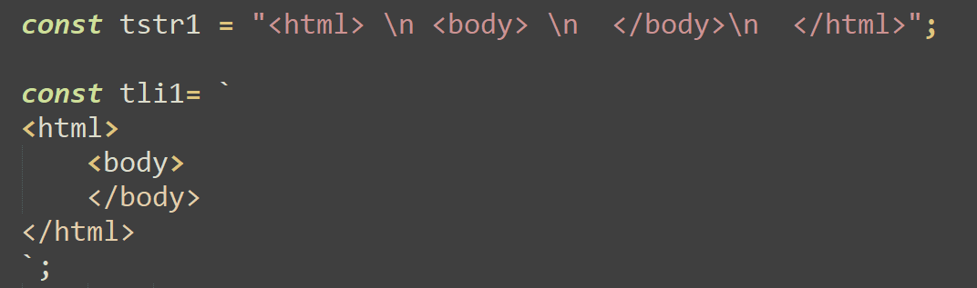
Template strings vs Template Literals

Slide 6
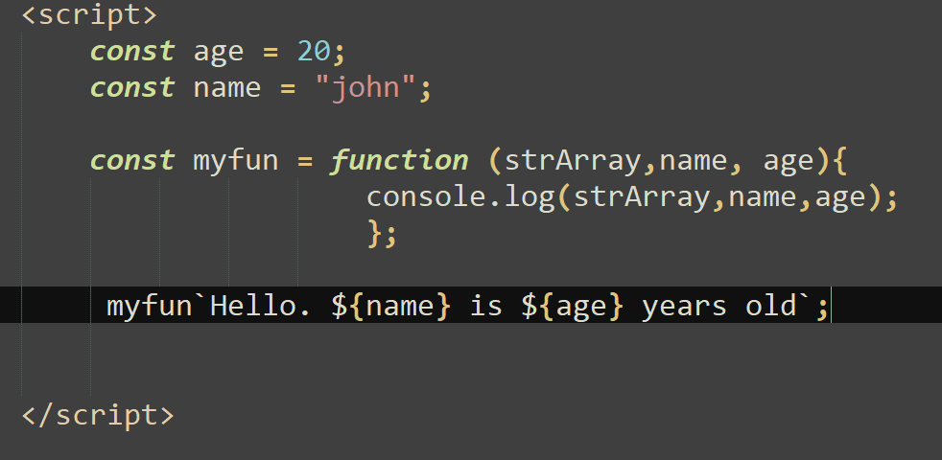
Tagged Templates (Tag Function)

Slide 7
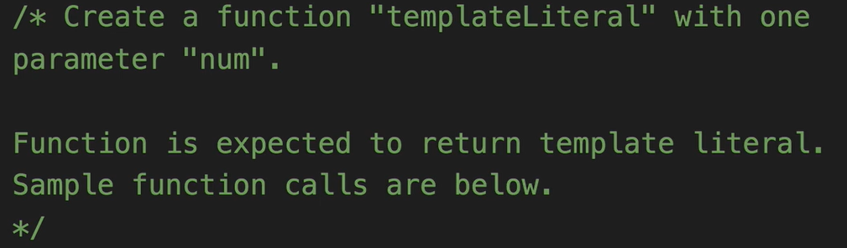
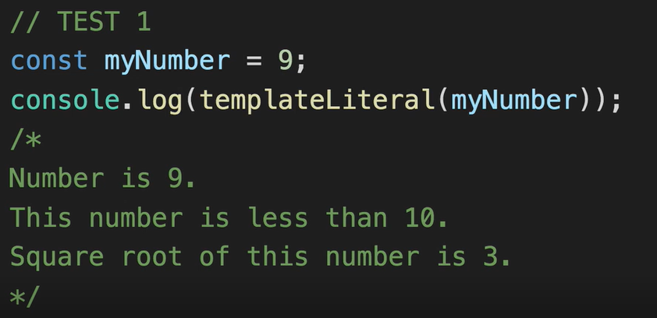
Challenge 1

Slide 8
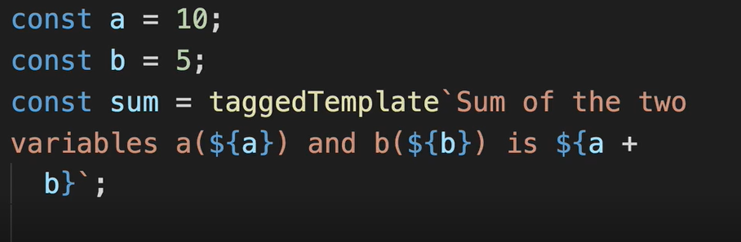
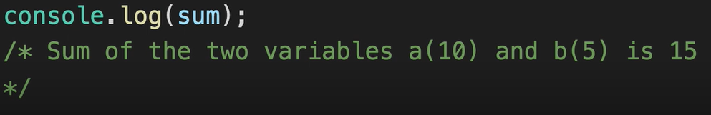
Challenge 2
Create a taggedTemplate function to satisfy the following test case.
Test Case

